Slide 1
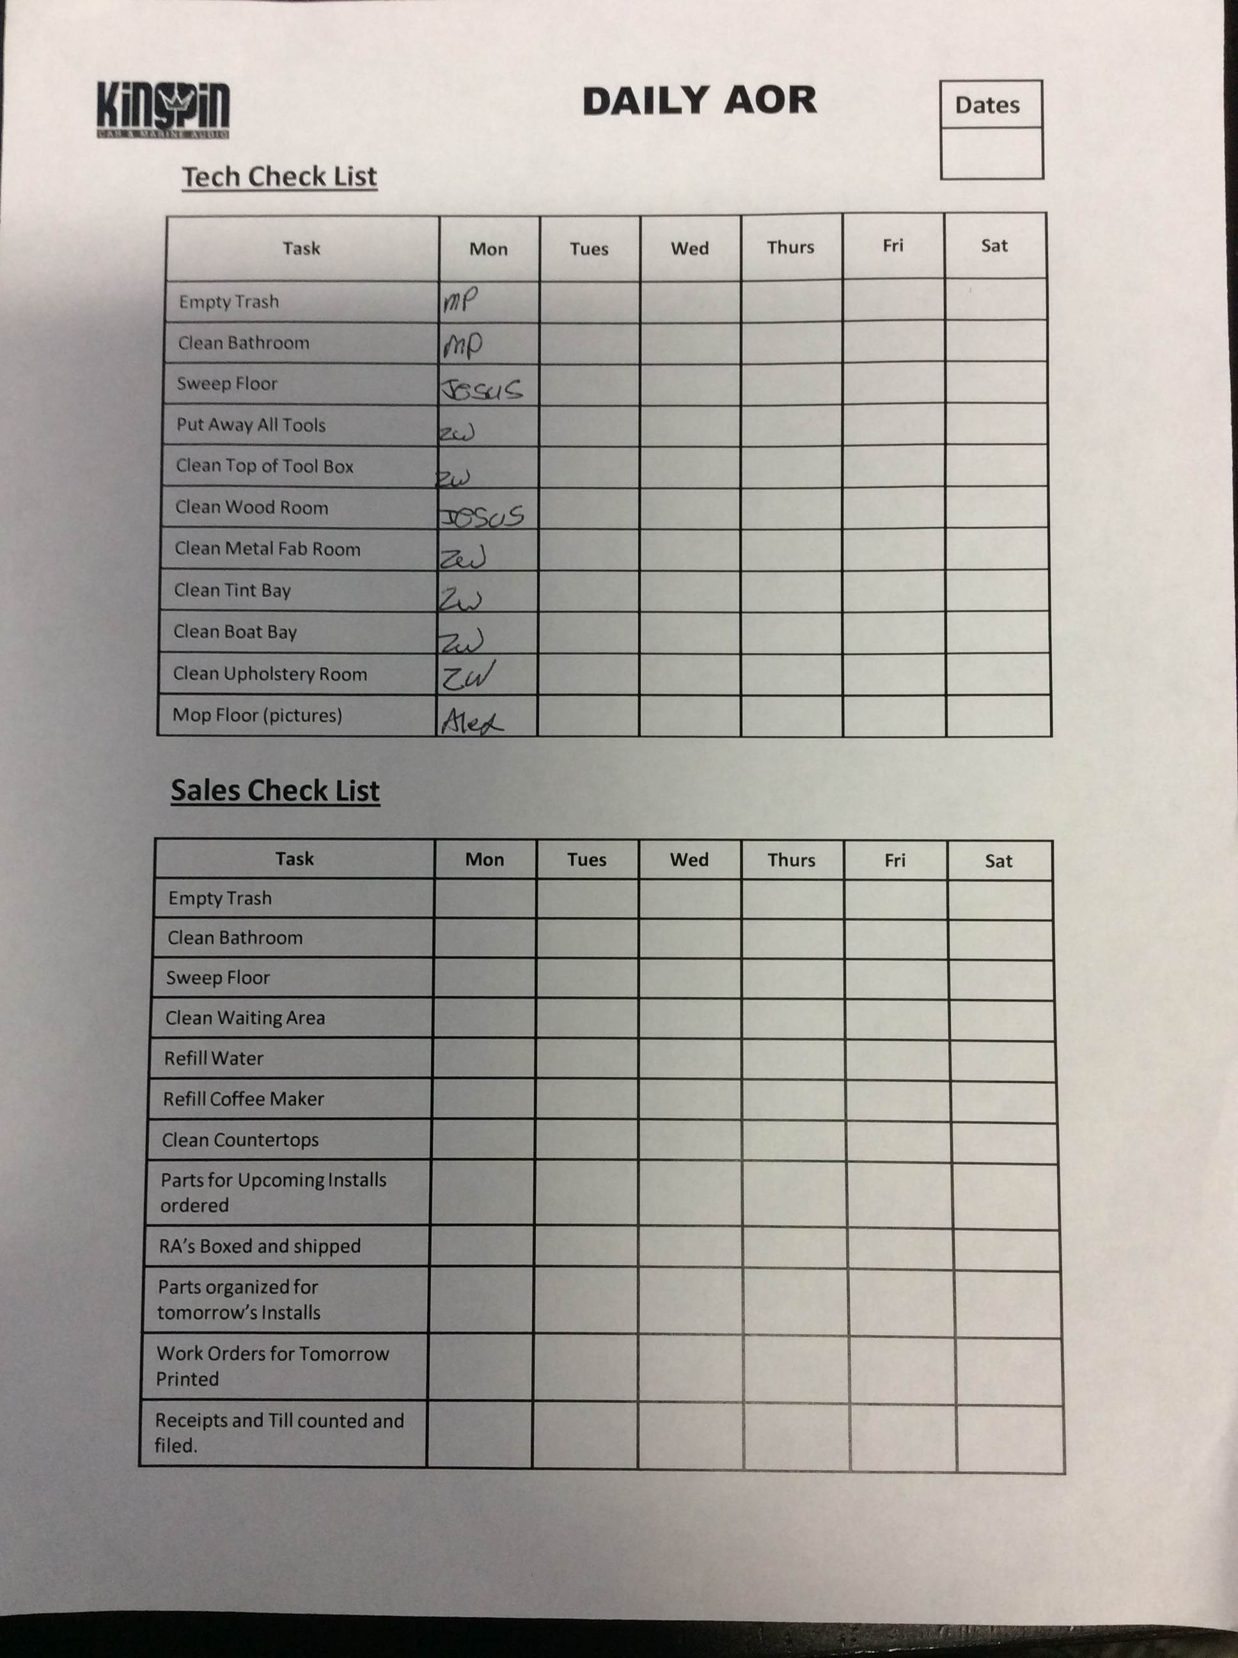
Customer
Service
Cleaning
Schedule

Slide 2
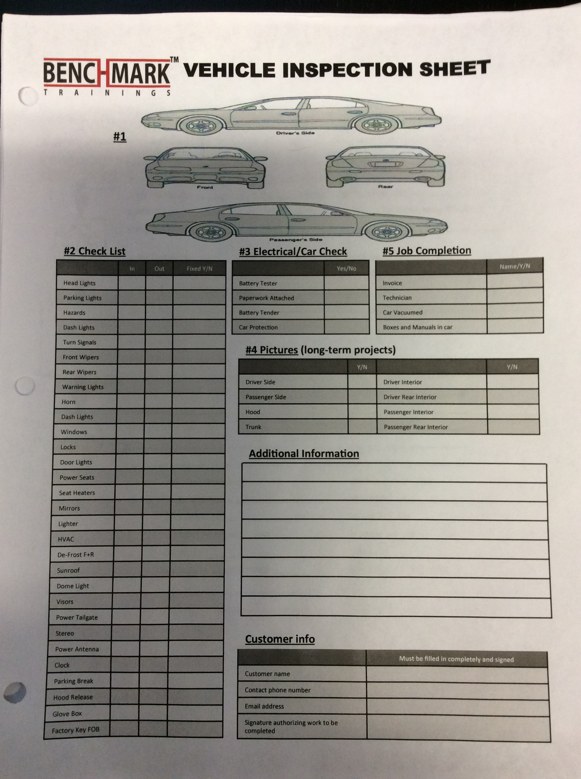
Customer service
Check in & out Sheets

Slide 3
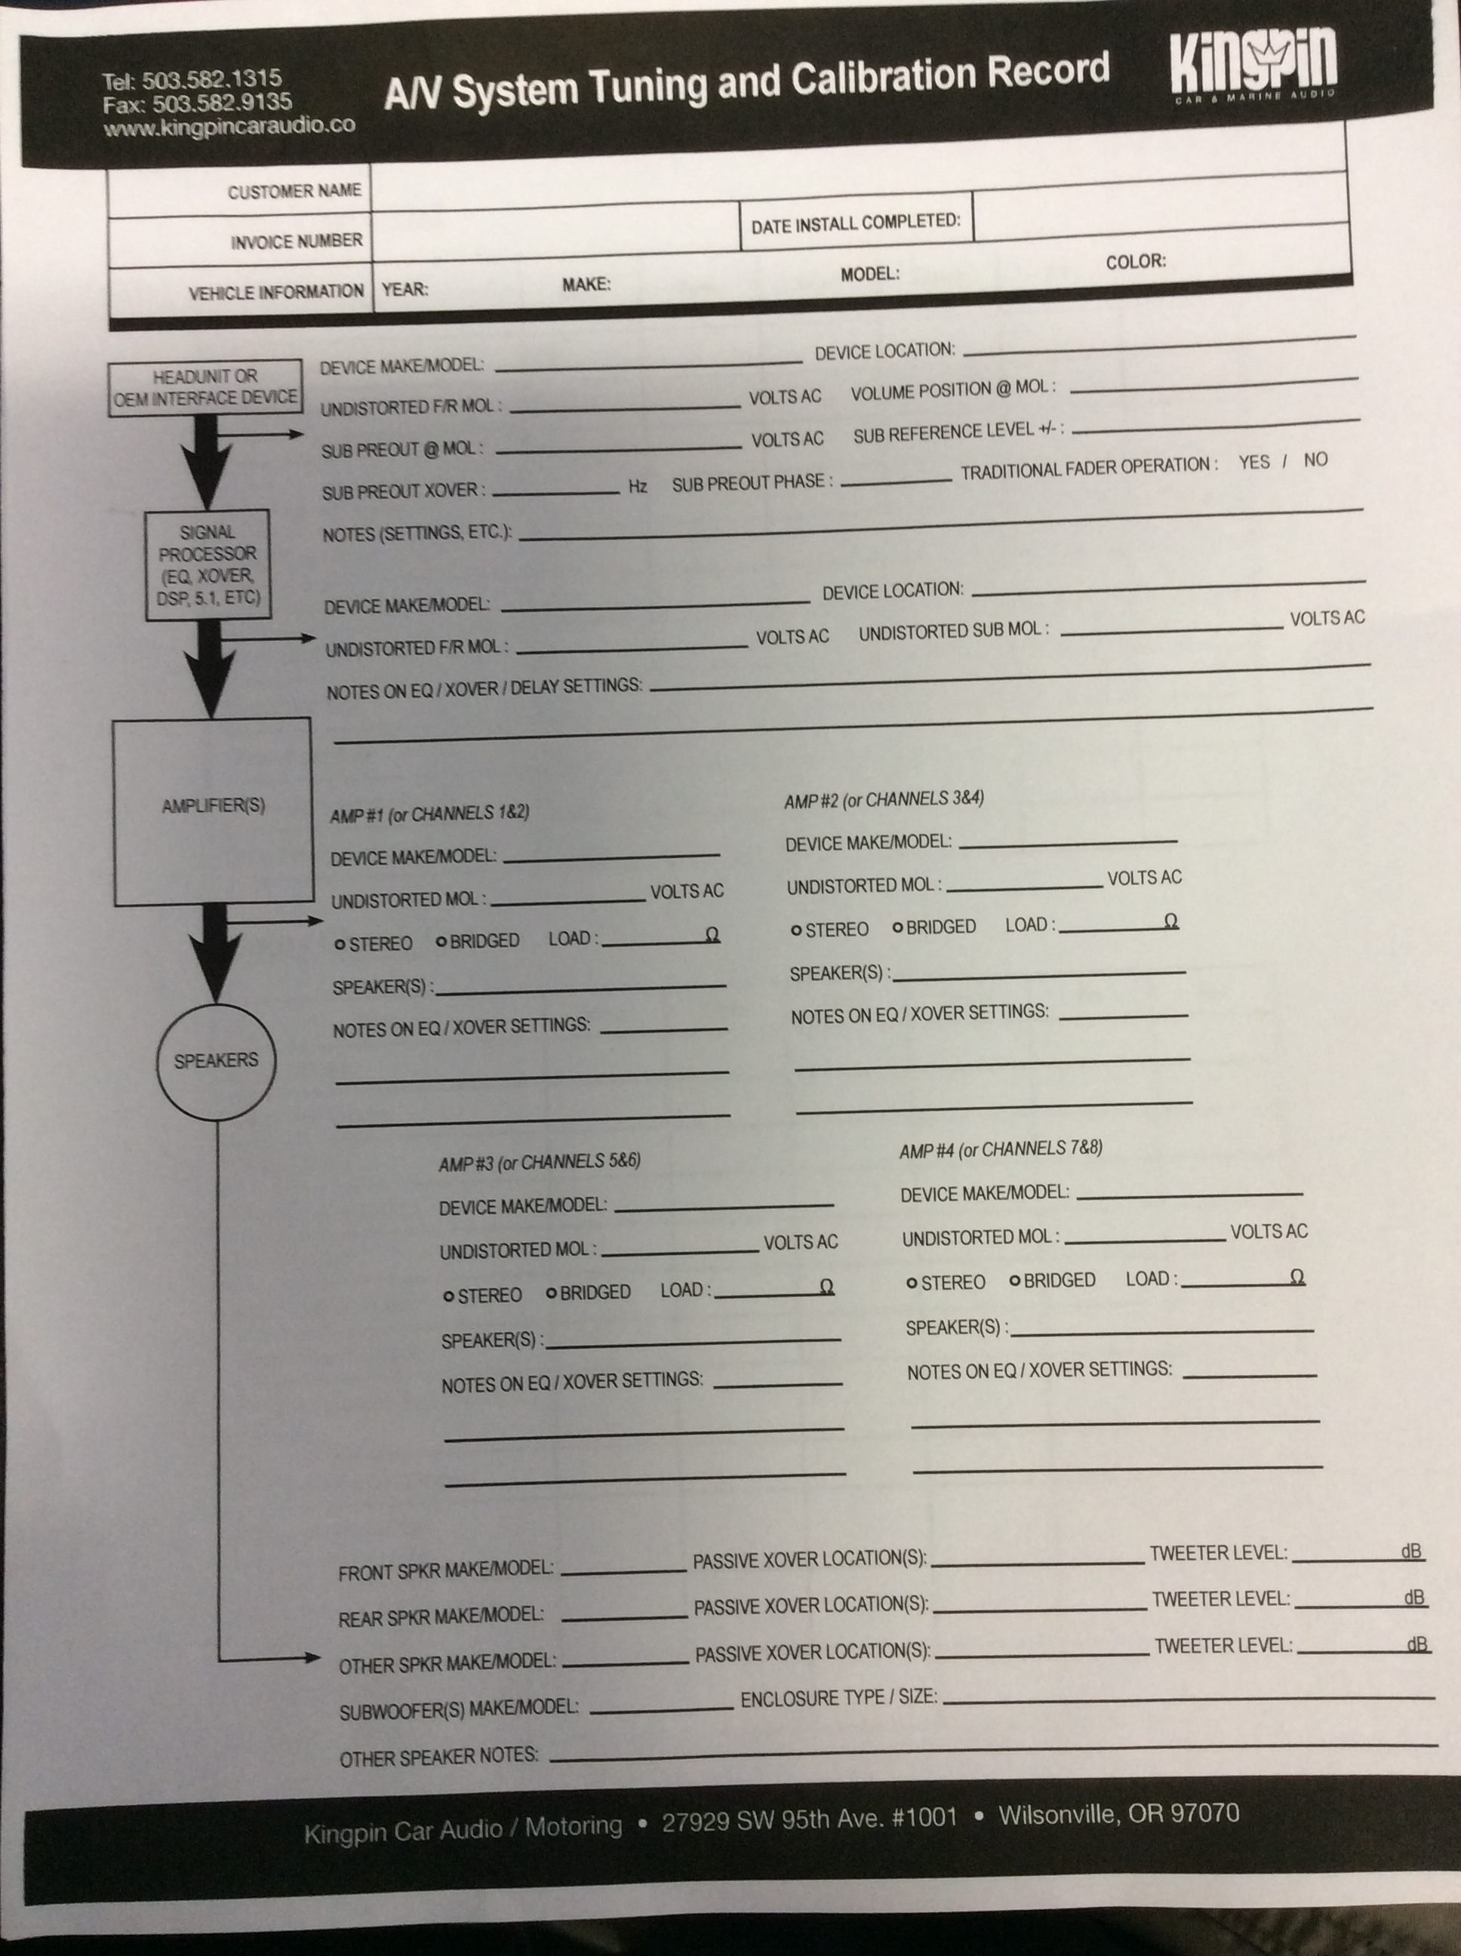
Customer Service
System tunning sheet

Slide 4
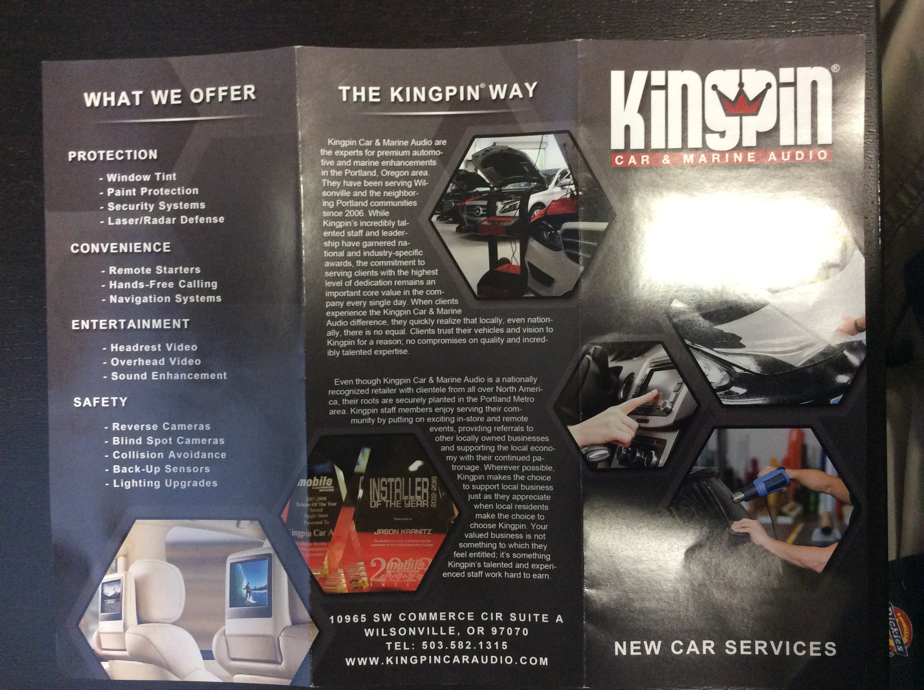
Sales and Marketing

Slide 5
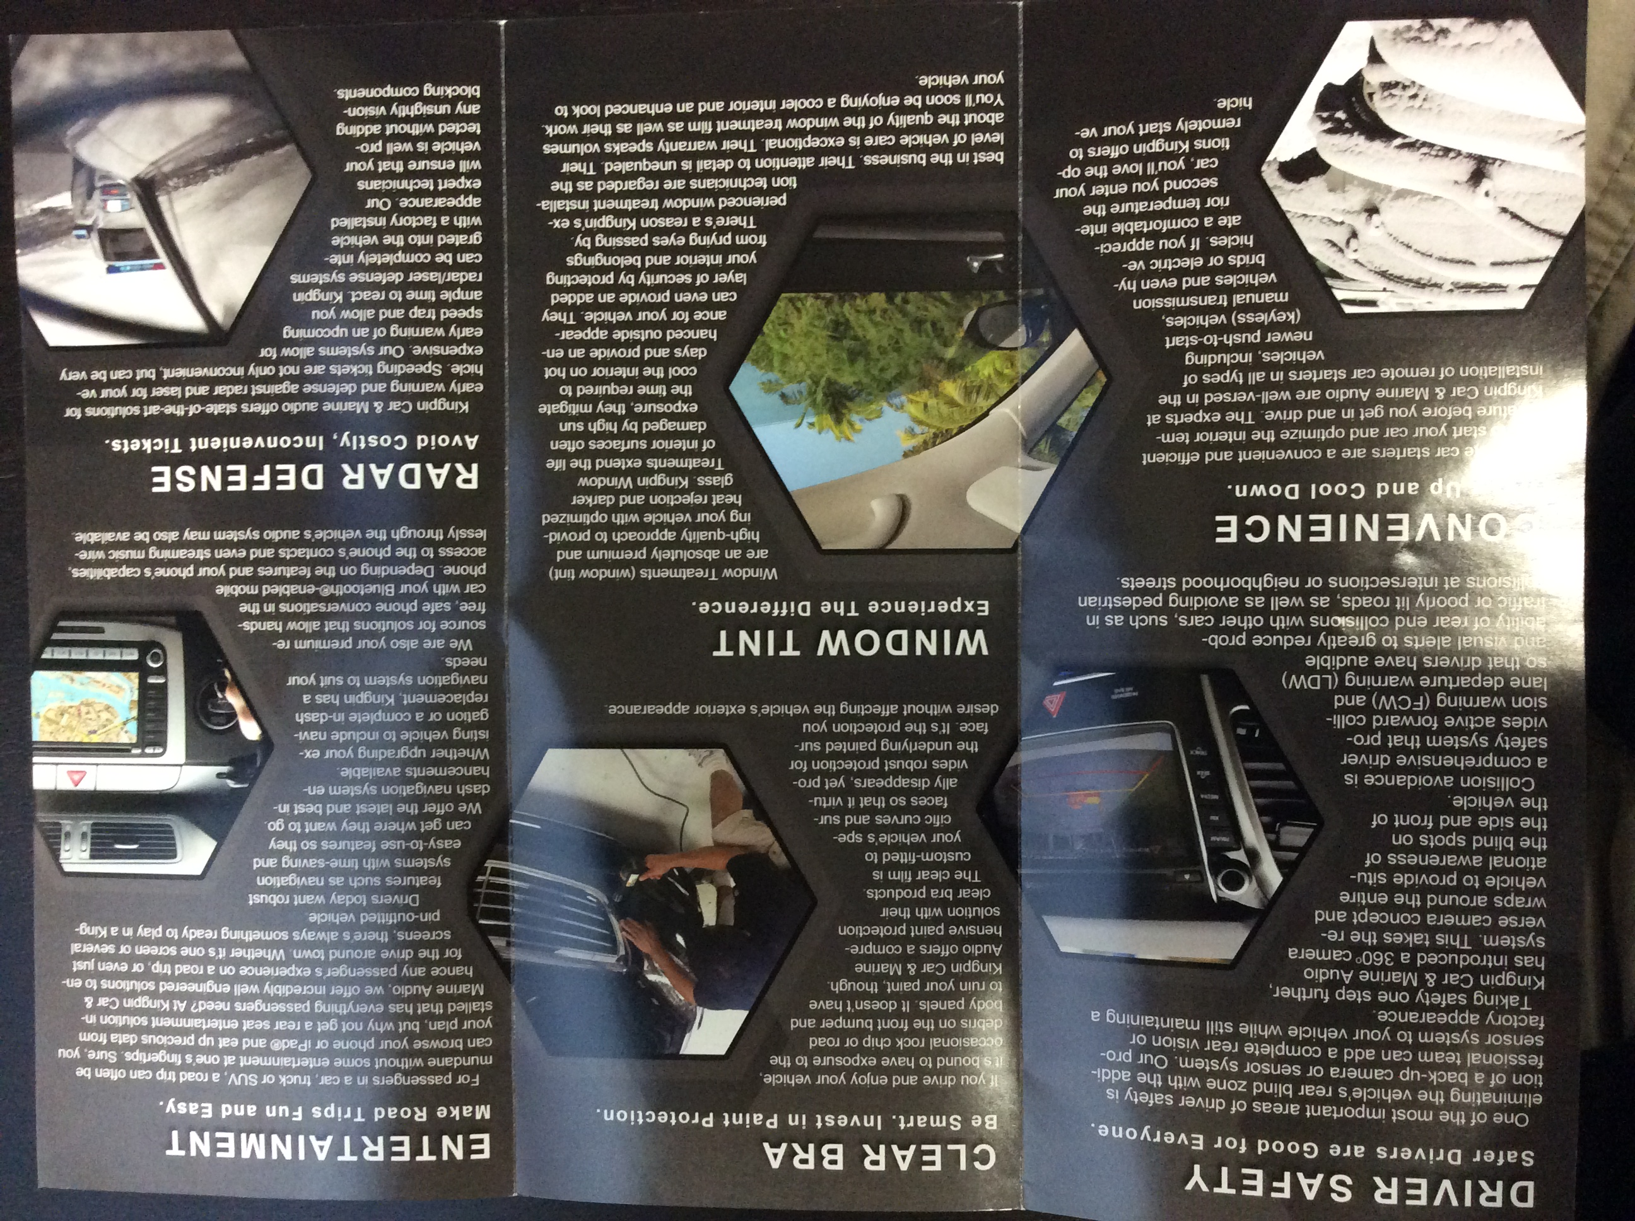
Sales and Marketing

Slide 6
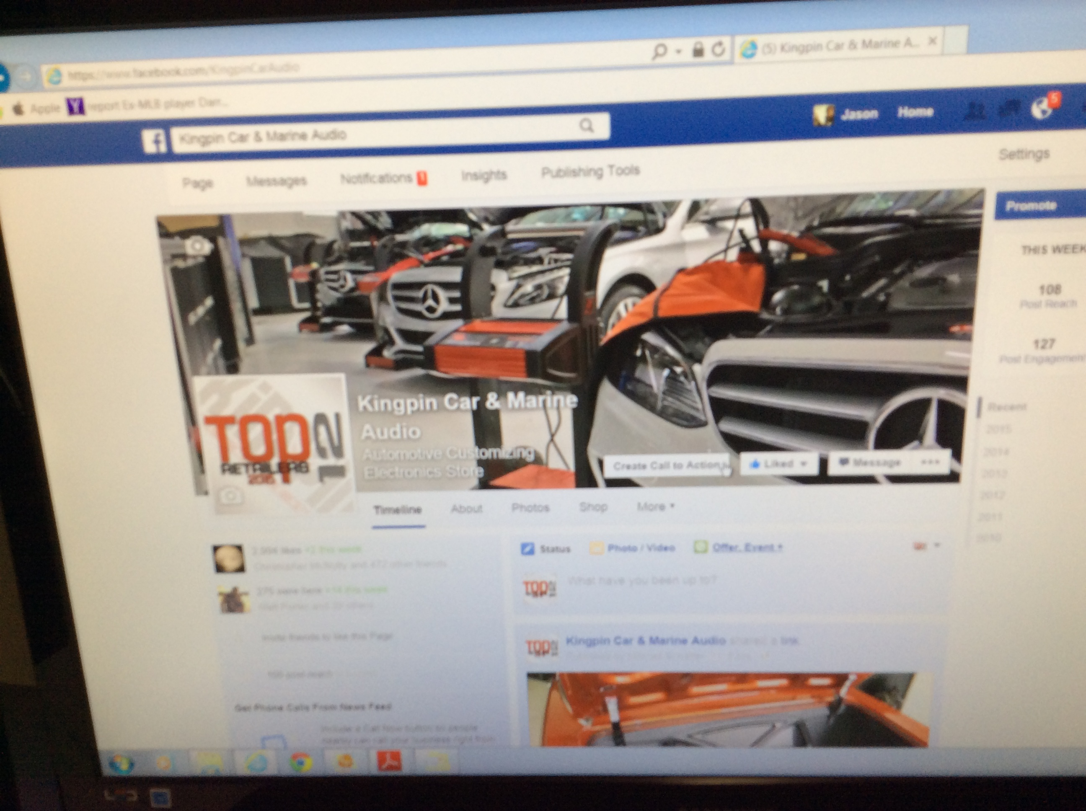
Sales and Marketing

Slide 7
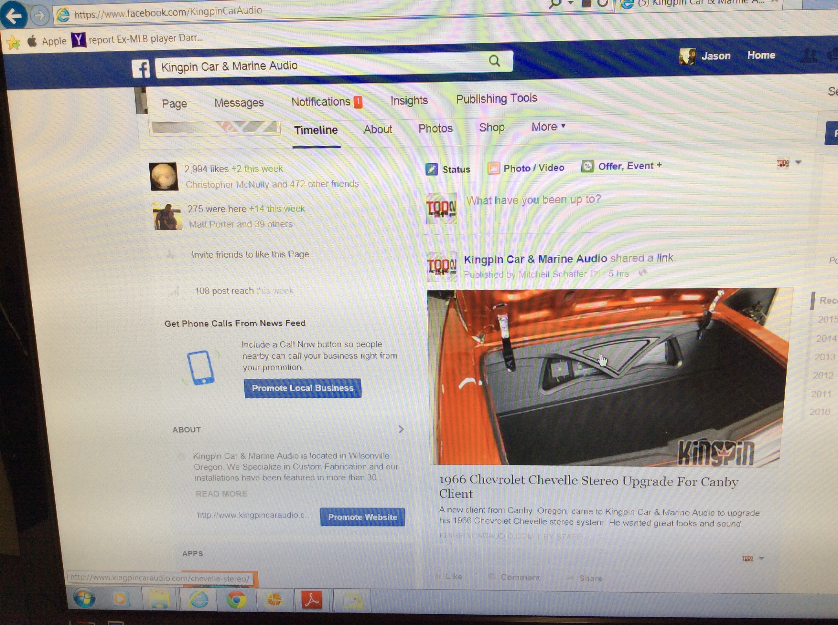
Sales and Marketing

Slide 8
Sales and Marketing

Slide 9
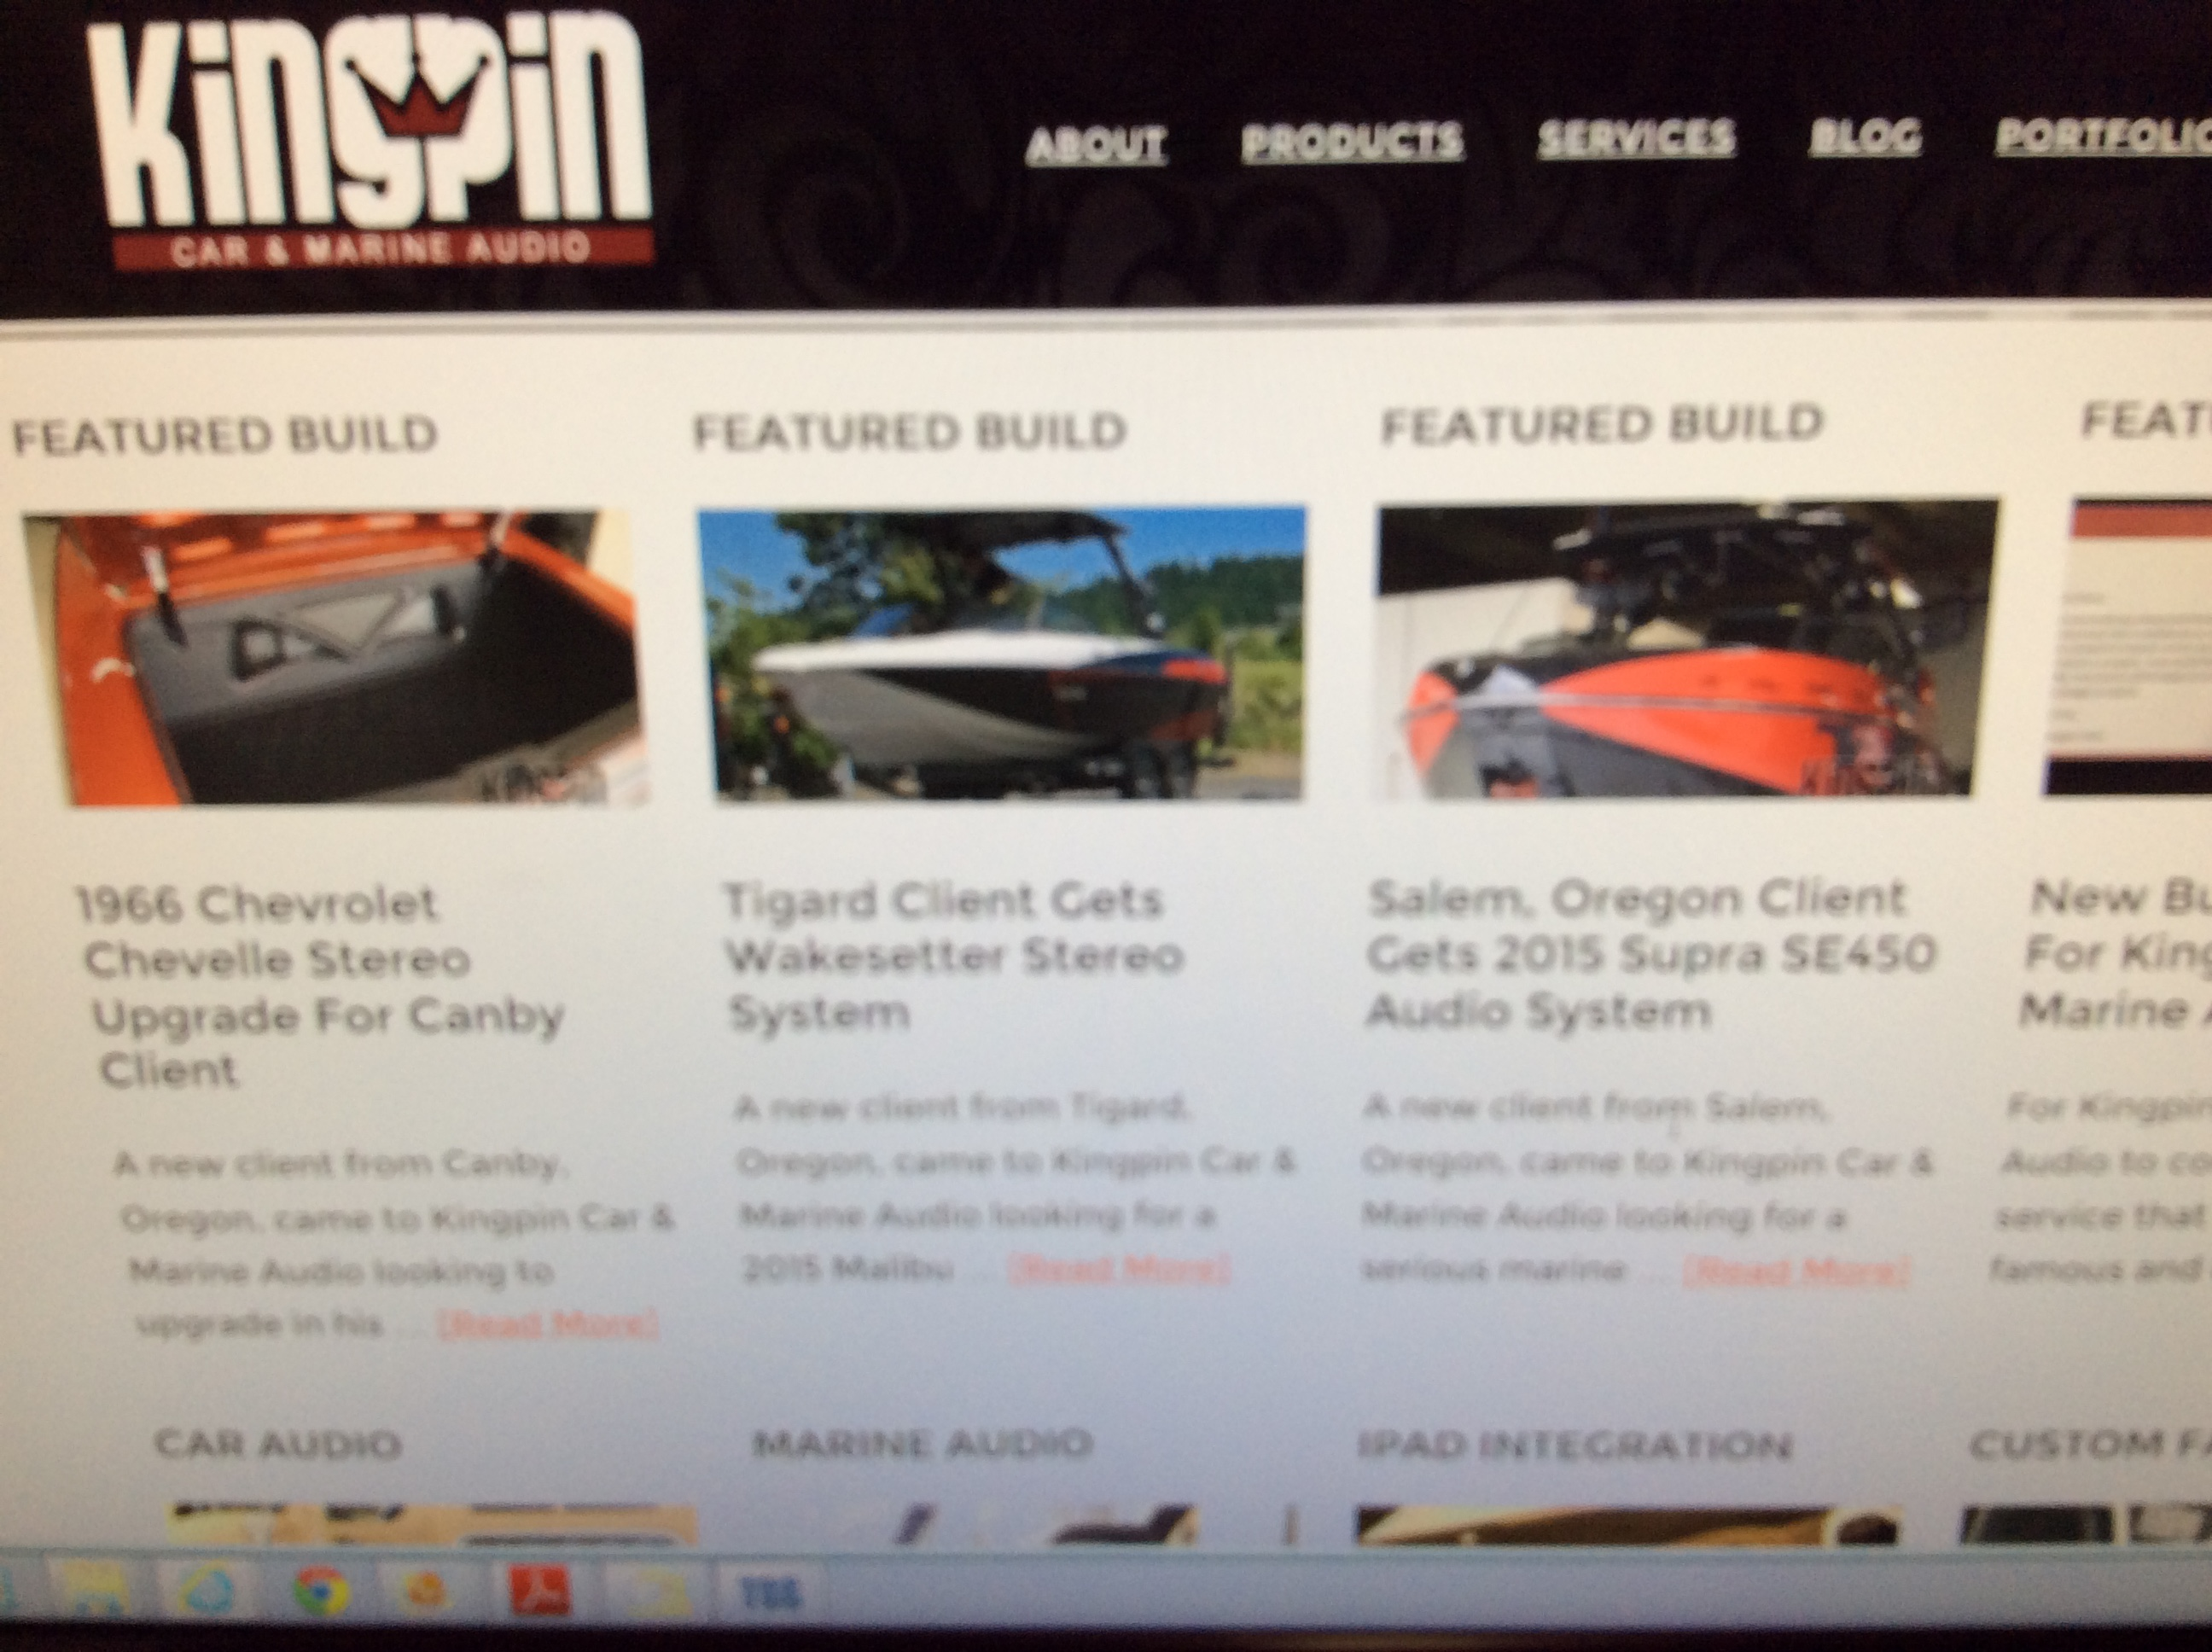
Sales and Marketing

Slide 10
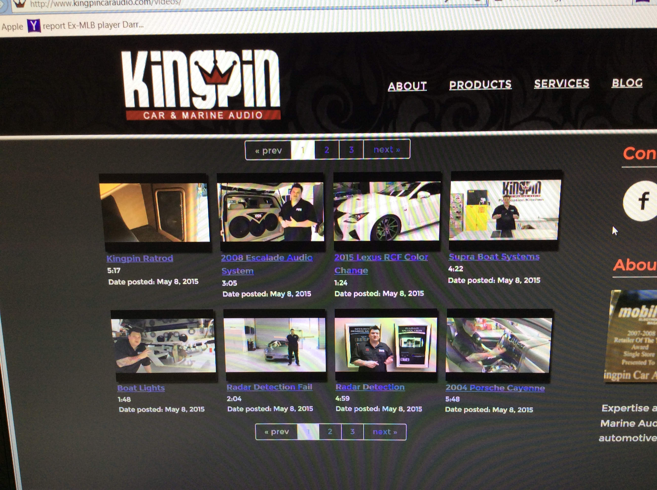
Sales and Marketing

Slide 11
Sales and Marketing

Slide 12
Sales and Marketing

Slide 13
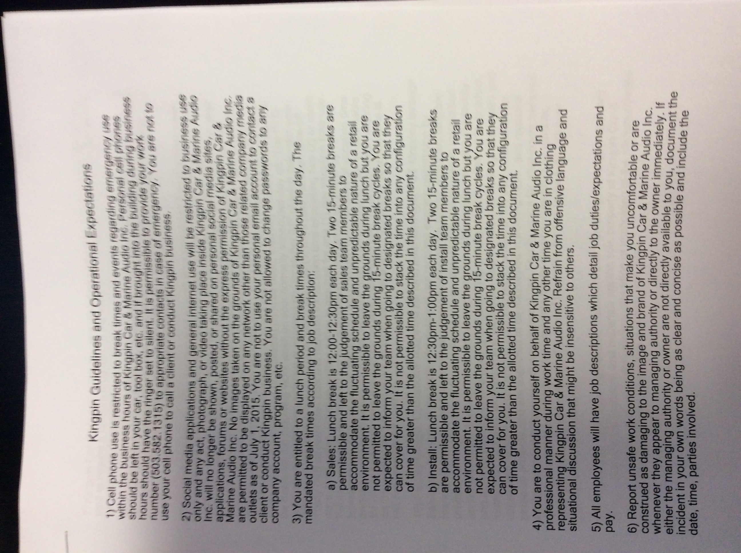
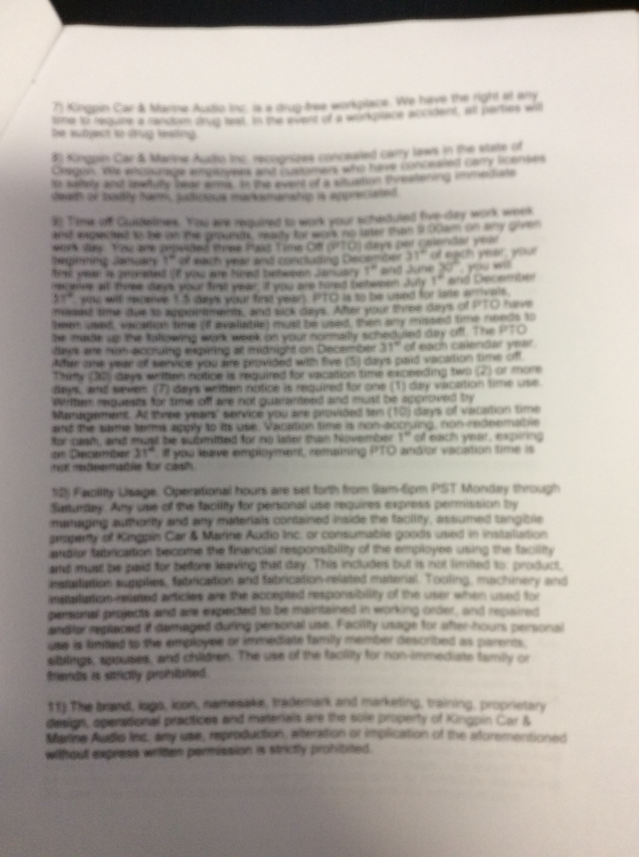
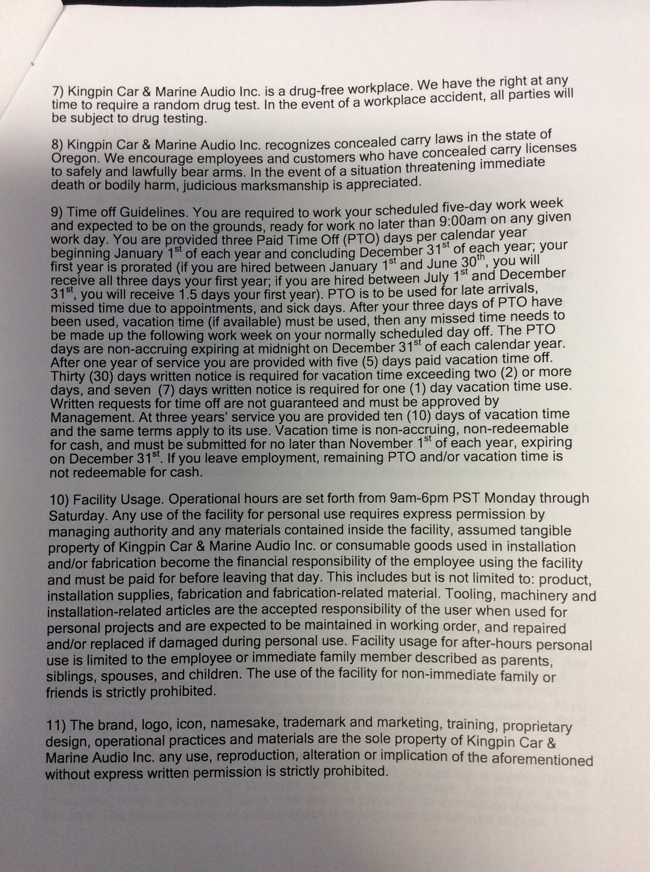
Staff Growth and Training

